Slide 1

Micro-Credit Defaulter Project
Submitted by:
Vinod Adep

Slide 2
INTRODUCTION
Business Problem Framing:-
A Microfinance Institution (MFI) is an organization that offers financial services to low income populations. MFS becomes very useful when targeting especially the unbanked poor families living in remote areas with not much sources of income. The Microfinance services (MFS) provided by MFI are Group Loans, Agricultural Loans, Individual Business Loans and so on.
Many microfinance institutions (MFI), experts and donors are supporting the idea of using mobile financial services (MFS) which they feel are more convenient and efficient, and cost saving, than the traditional high-touch model used since long for the purpose of delivering microfinance services. Though, the MFI industry is primarily focusing on low income families and are very useful in such areas, the implementation of MFS has been uneven with both significant challenges and successes.
Today, microfinance is widely accepted as a poverty-reduction tool, representing $70 billion in outstanding loans and a global outreach of 200 million clients.

Slide 3
We are working with one such client that is in Telecom Industry. They are a fixed wireless telecommunications network provider. They have launched various products and have developed its business and organization based on the budget operator model, offering better products at Lower Prices to all value conscious customers through a strategy of disruptive innovation that focuses on the subscriber.
They understand the importance of communication and how it affects a person’s life, thus, focusing on providing their services and products to low earnings families and poor customers that can help them in the need of hour.
They are collaborating with an MFI to provide micro-credit on mobile balances to be paid back in 5 days. The Consumer is believed to be defaulter if he deviates from the path of paying back the loaned amount within the time duration of 5 days. For the loan amount of 5 (in Indonesian Rupiah), payback amount should be 6 (in Indonesian Rupiah), while, for the loan amount of 10 (in Indonesian Rupiah), the payback amount should be 12 (in Indonesian Rupiah).
The purpose of this sample data is used to improve the selection of customers for the credit, to help them in further investment and improvement in selection of customers

Slide 4
Conceptual Background of the Domain Problem Data is gather from Microfinance Institution (MFI) the aim of this is institutions to offers financial services to low income populations. MFS becomes very useful when targeting especially the unbanked poor families living in remote areas with not much sources of income. The Microfinance services (MFS) provided by MFI are Group Loans, Agricultural Loans, Individual Business Loans and so on.
Motivation for the Problem Undertaken
Motive of this project is to determine the customer is defaulter or not it means customer would pay interest and repay the loan or not. Motive is to collect the customer those are legitimate to repay the loan with interest.

Slide 5

Analytical Problem Framing
Mathematical/ Analytical Modelling of the Problem
In this sample data gives lot’s of information to predict a customer is defaulter or not. Data contain 209593 rows and 36 Columns. Data has no missing values all the column having some data. Some of the columns are in integer and some are in Object. There is msisdn column type is object each row having a number with one alphabet ‘I’ in middle of the string to convert is object to integer i converted alphabet ‘I’ to blank. Then column is in string number so i typecast each rows to integer same as these i replaced UPW to 1 in p circle column. I have handle date time column to make day, week and Year column differently so datetime column information will give in three different column with data type integer

Slide 6
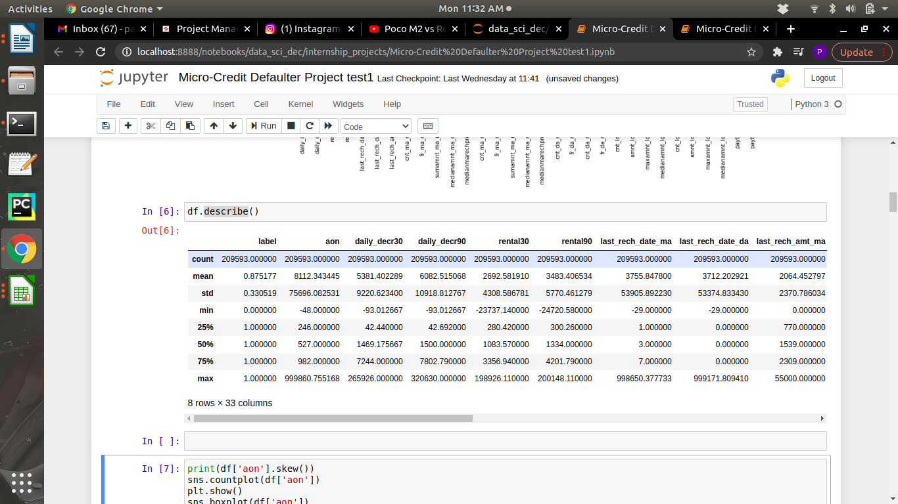
Data Sources and their formats
The data is dispersed with an heigh variance on continues data. Minimum value and mean value having large difference so we can say that data have some outliers or having heigh skewness in the data i.e. (Right skewed and Left Skewed).

Slide 7
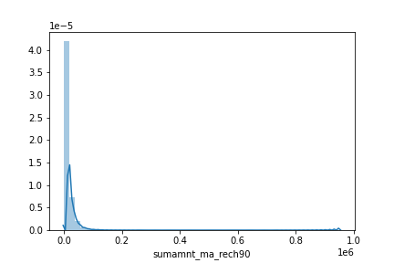
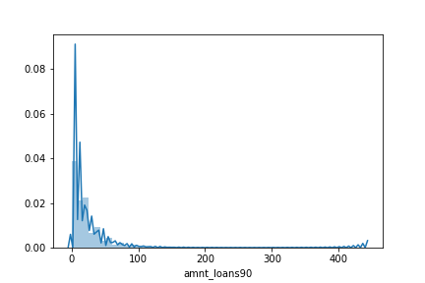
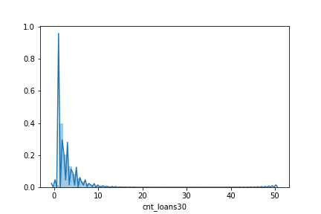
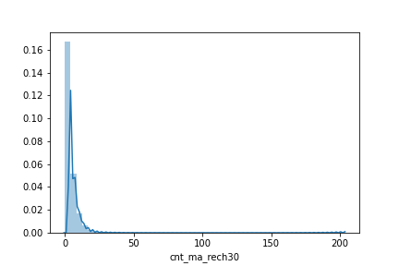

Slide 8
Data Pre-processing Done
In this data all the columns having data in different range. So not to bias on columns i have pre-process the data to scale all the columns in a similar range. I have to used the Standard Scaler class from pre-processing to Scale all columns in a similar range to do not bias a machine while model generation. By Scaling on Label data dataset become in a similar range and machine cannot be bias.

Slide 9
Model/s Development and Evaluation
Identification of possible problem-solving approaches (methods)
The data set contain label data and target data label has cleaned by some EDA steps. Target data is in the form of classified factor’s 1 / 0 i.e. (success and failure). By seeing the our target column we can conclude that this problem comes under supervised and Classification Problem. Target column having in factor logistic regression can be used for predictions because it is best when the target column having in factors. For more testing SVC, Decision Tress Classifier, KNN algorithms have used. Rather testing on one by one algorithm and choosing best algorithm and hyper tuning that best model. I have hyper tunned all the algorithm and added into pipeline so i will get best algorithm along with the best parameters

Slide 10
Testing of Identified Approaches (Algorithms) For testing how good model is generated. I have split data set into two parts (70% 30%) and each part is split into further two part that are label data and target data. First 70% split data is used for training the model and another rest of 30% used for Prediction testing the model how good model is predicted in terms of percentage
List of Algorithms that I have used:-
Logistic Regression
Decision Tress Classifier
KNN
SVC

Slide 11
Run and Evaluate selected models
After running Pipeline it has gave best model is KNN Classifier with a 88% accuracy. For to represent accuracy in graphical manner I have plot AUC ROC curve. KNN Classifier Algorithm is used collect N neighbours to that point and rank that points.
E.g. N_neighbours=7
Any random point is used to collect 7 points nearest to the random point and rank that points If out of 7points 4points represents 1(success) and rest 3 are 0(failure). Highest points are 1 near to that random point it will predict that random point is 1(success).

Slide 12
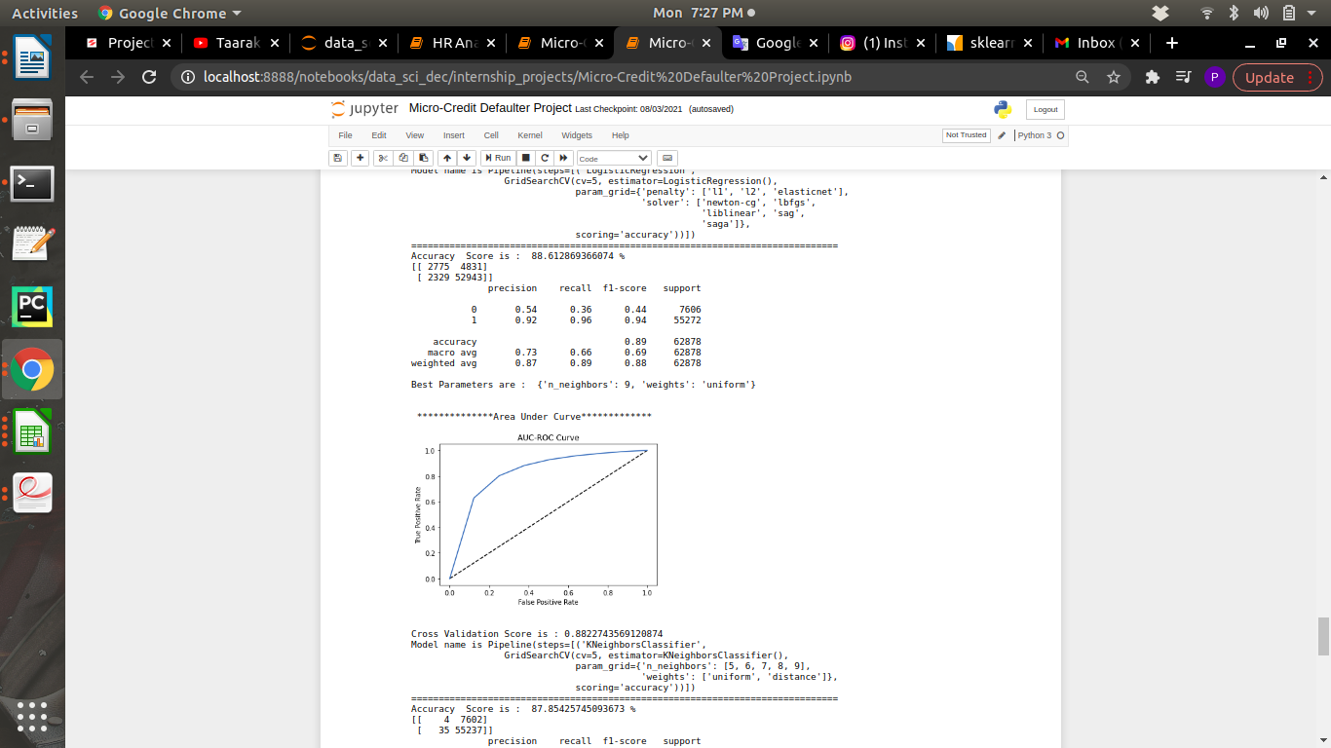

Slide 13
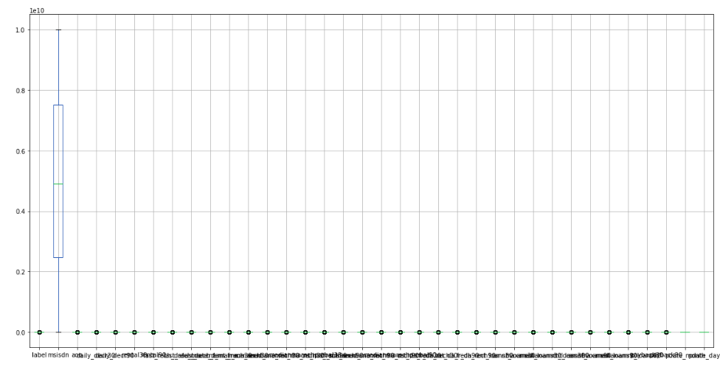
Visualizations
Box plot show tat there is no outliers present in the dataset.
Box plot show tat there is no outliers present in the dataset.

Slide 14
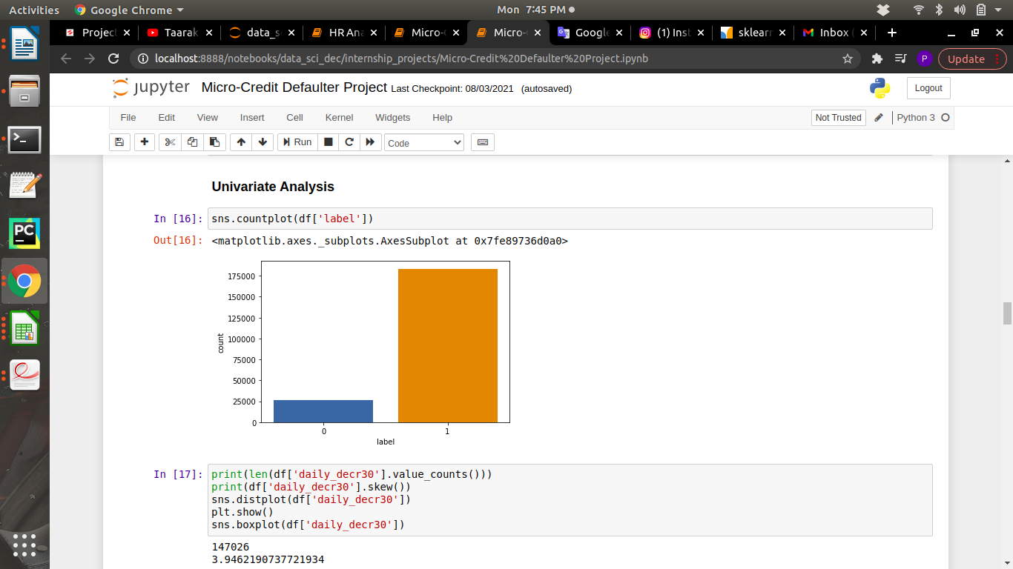
Count plot showing the count of 0’s and 1’s. It show that 1’s have more than 75% and 0’s have near to 25%.

Slide 15
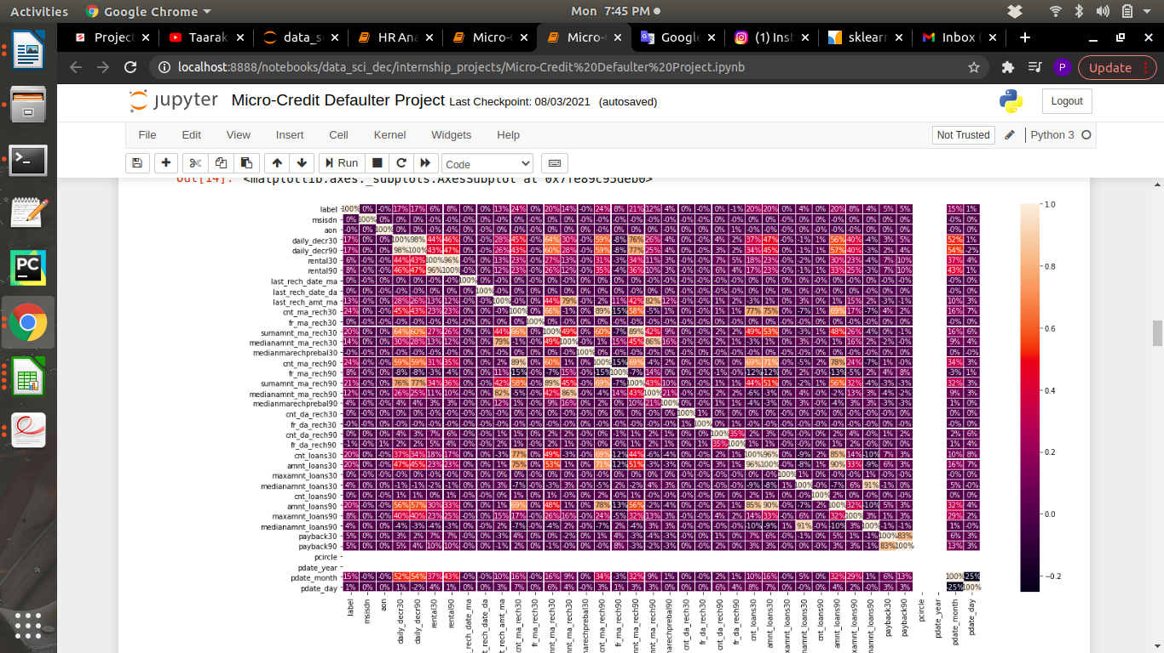
Above heatmap shows percentage of correlating with target column i.e. label. It helps a lot to understand which column heigh correlating with target column which affects more while predicting.

Slide 16
Interpretation of the Results
From visualization i got to know that data set have no null values, how much correlating with target column and how the data is skewed and distributed. And count of defaulter and non defaulter. Through pre-processing and scaling the data set become unbiased while model generating. Lastly by applying some algorithm in pipeline it has given the best model with the best parameter. Best model has given with the best parameter so the problem of over fitting and underfitting is solved.

Slide 17
CONCLUSION
Learning Outcomes of the Study in respect of Data Science
I have learn some inbuild function of python at the time of data cleaning. Object columns to Integer are done by using python map function over on lambda function. The main challenging is that to run all model once and get the best model name with best parameters also with a AUC ROC curve plot. This is done by using pipeline. This will helps me to get out from overfitting and underfitting.

